Slide 1
Predicting Emotional State
Texas A&M MS Final Presentation
Anthony Sedarous

Slide 2

Who am I?
Me
Graduated from UW-Madison in 2012
Lived on the east coast [Richmond, VA] for a few years; eventually moved to California
Currently work as a Data Scientist for Facebook
I’m the guy that puts ads in your FB videos

Slide 3
Motivation
A previous study was done investigating the impact of different distractions [analytical, emotional, texting] on a subject’s ability to drive
The study concluded that emotional and analytical distractions had little impact on a subject’s ability to drive; texting definitely notably changed driving behavior
Using the same dataset, we will attempt to construct a model in order to predict whether, at a given point in time, a subject is in a distracted emotional state.
Previous analysis done by Stephanie Parker showed that the emotional tracker might not be the greatest; we will build our model with that limitation in mind
Being able to understand what correlates with a driver being distracted could allow for additional safety features in cars and, hopefully, reduce emotionally induced accidents

Slide 4
The Data / Setup
Our data measures every second across 8 drives for a multitude of drivers
Removing NA data leaves us with 53 drivers; ~61% female / 53% Young
We only look at five of those drives (Drives 4-8) since the others are calibration / warm up drives
On drives 5-8, the subjects are exposed to stimuli in order to see how they react
On Drive 5, drivers are asked an analytical/mathematic question; Drive 6 has an emotional question, Drive 7 requires the subjects to text, Drive 8 has texting with a sudden failure
At every point in time we are able to measure the probability a driver is feeling a certain emotion using face tracking software along with other drive-specific variables

Slide 5
Prior Approaches / Attempts
I tried to do two other things in the modeling;
Predict the change in emotion between time t-1 and time t;
This event turned out to be a primarily noise-driven process. Somer’s D maxed out around .350 after extensive feature mining
Determine that large amounts of shifting within a lane were indicative that a driver was in a distracted emotional state
This approach was a significant predictor of the change between emotional states but did not end up being a significant predictor in our model predicting actual emotional state

Slide 6
EDA / Understanding the Data

Slide 7
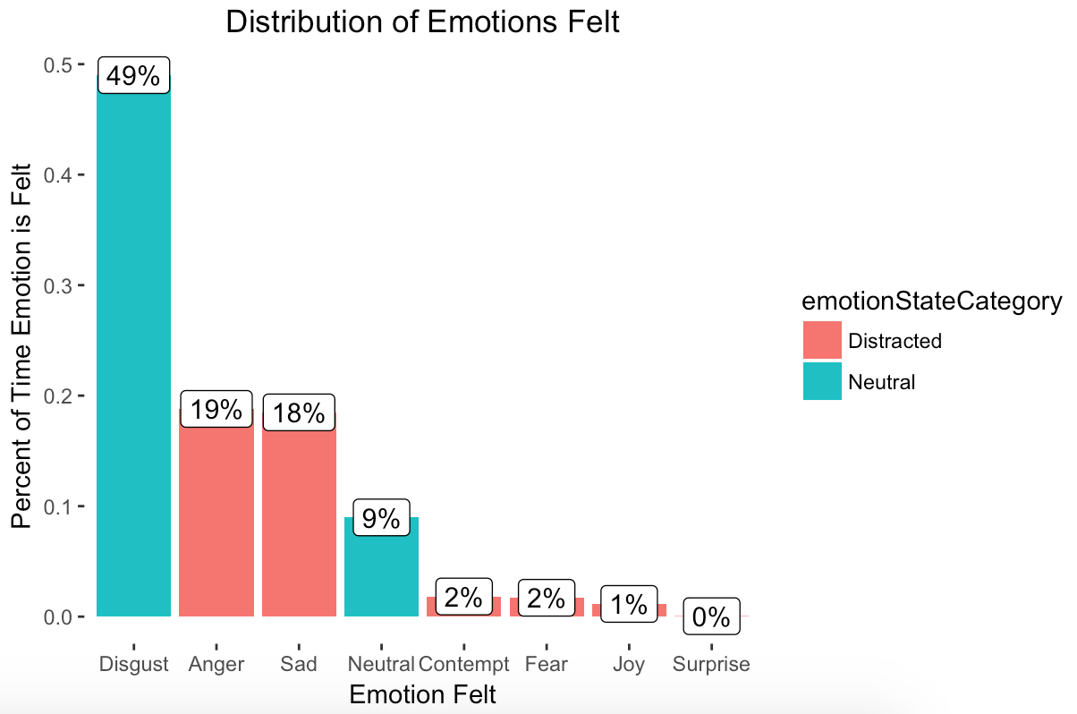
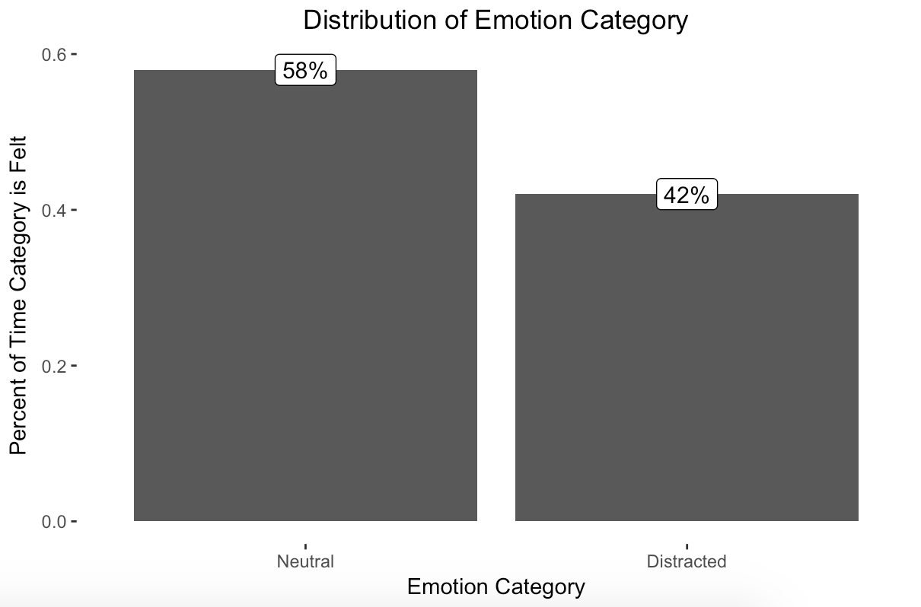
We consider the emotions ‘Disgust’ and ‘Neutral’ to be normal; Drivers are in normal states 58% of the time
TODO: Colorize

Slide 8
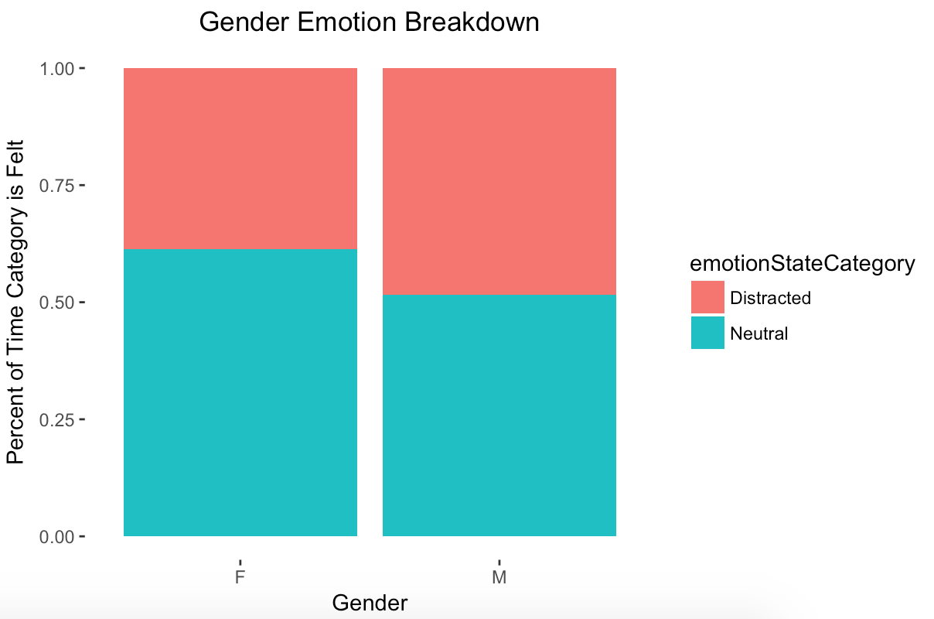
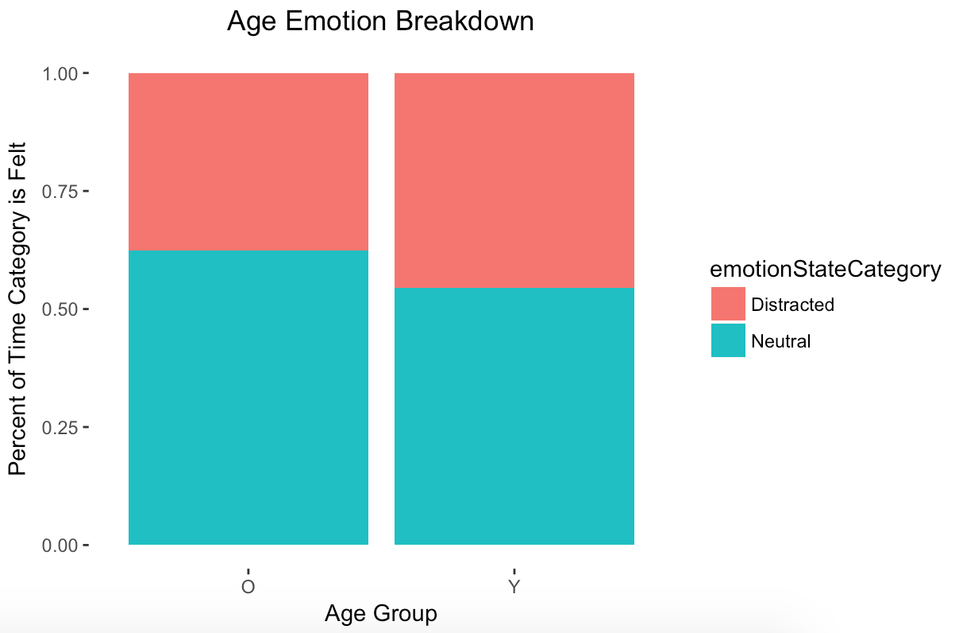
Male Drivers are distracted more often; Younger Drivers likewise
TODO: Colorize

Slide 9
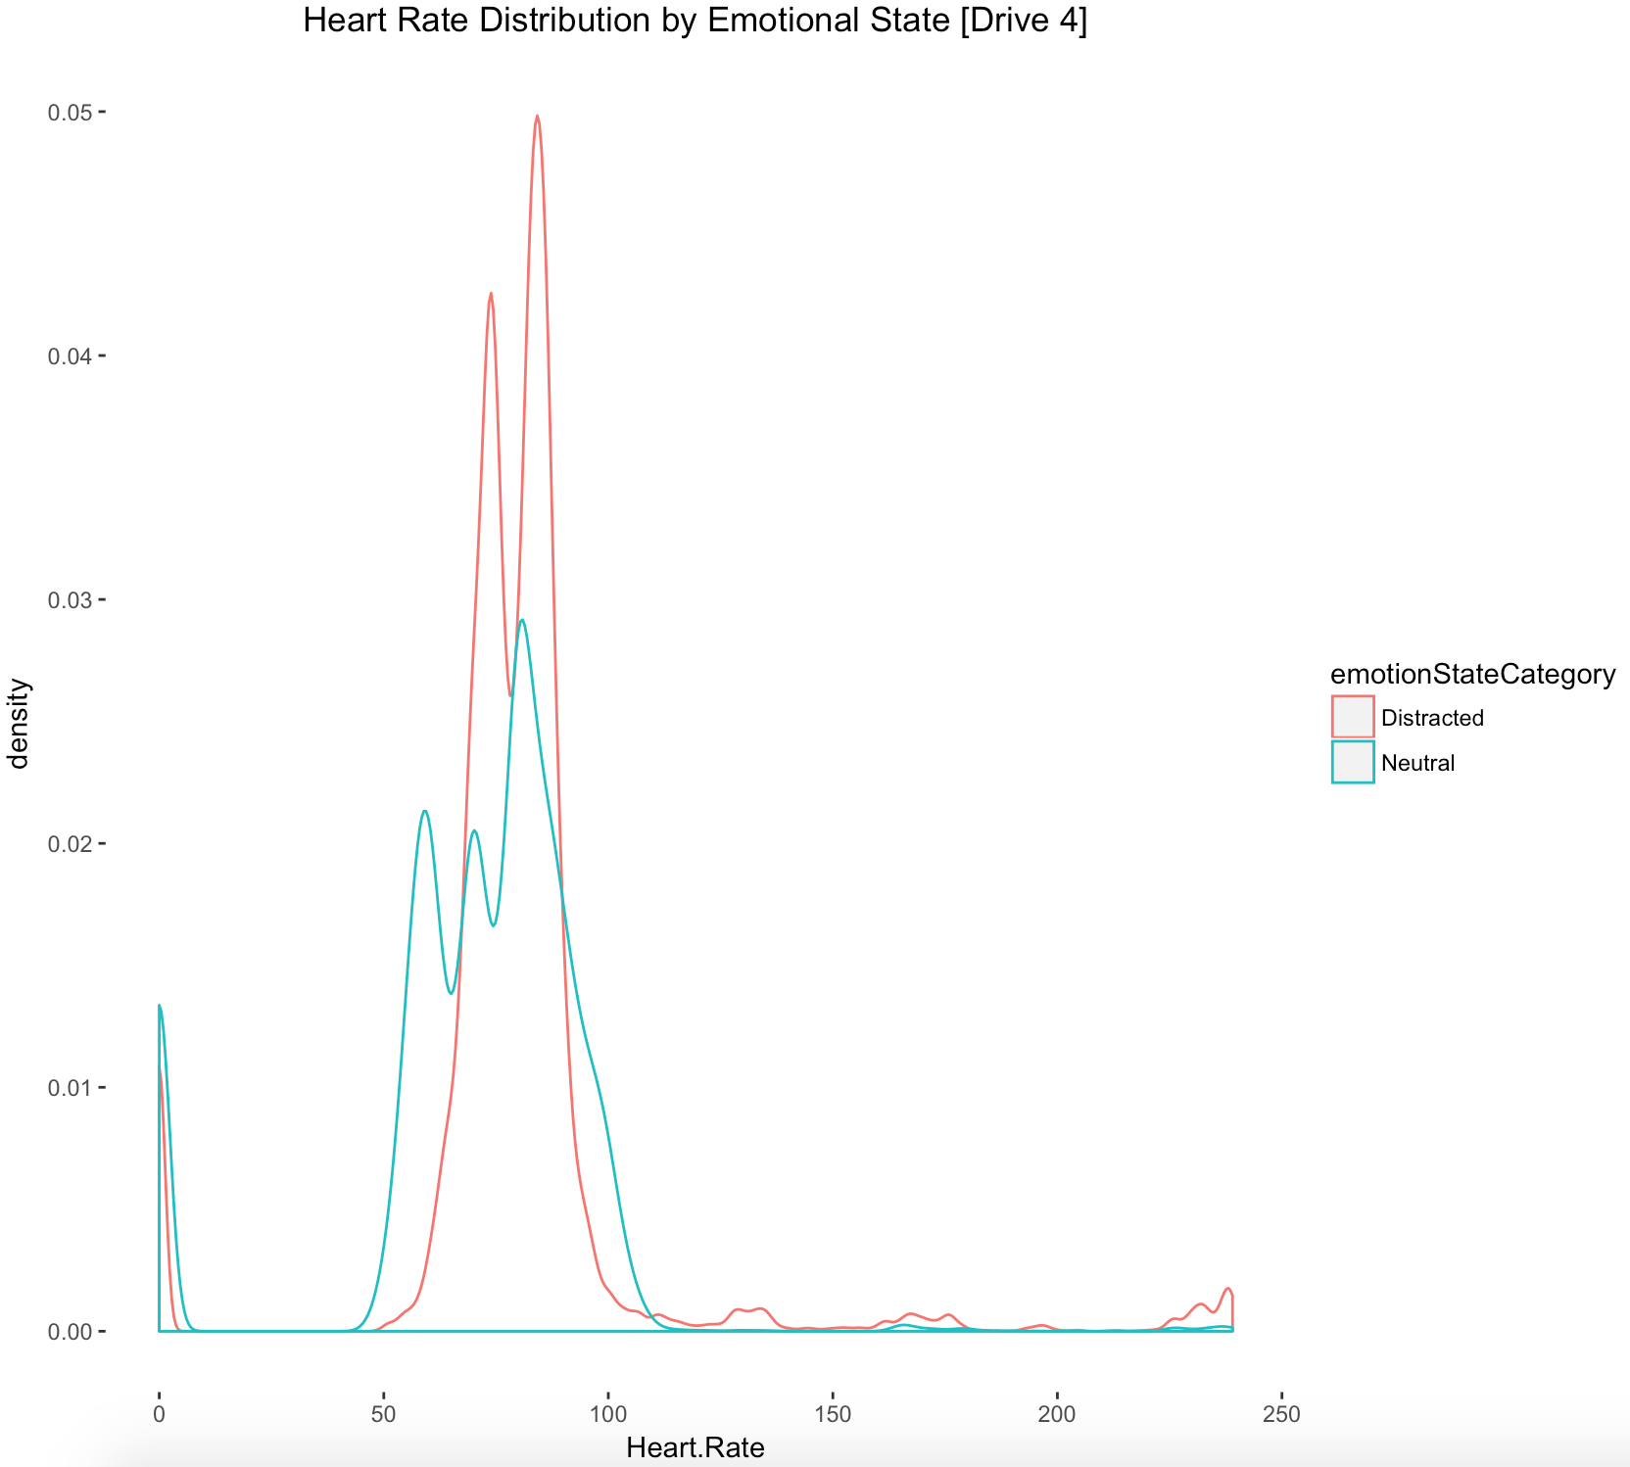
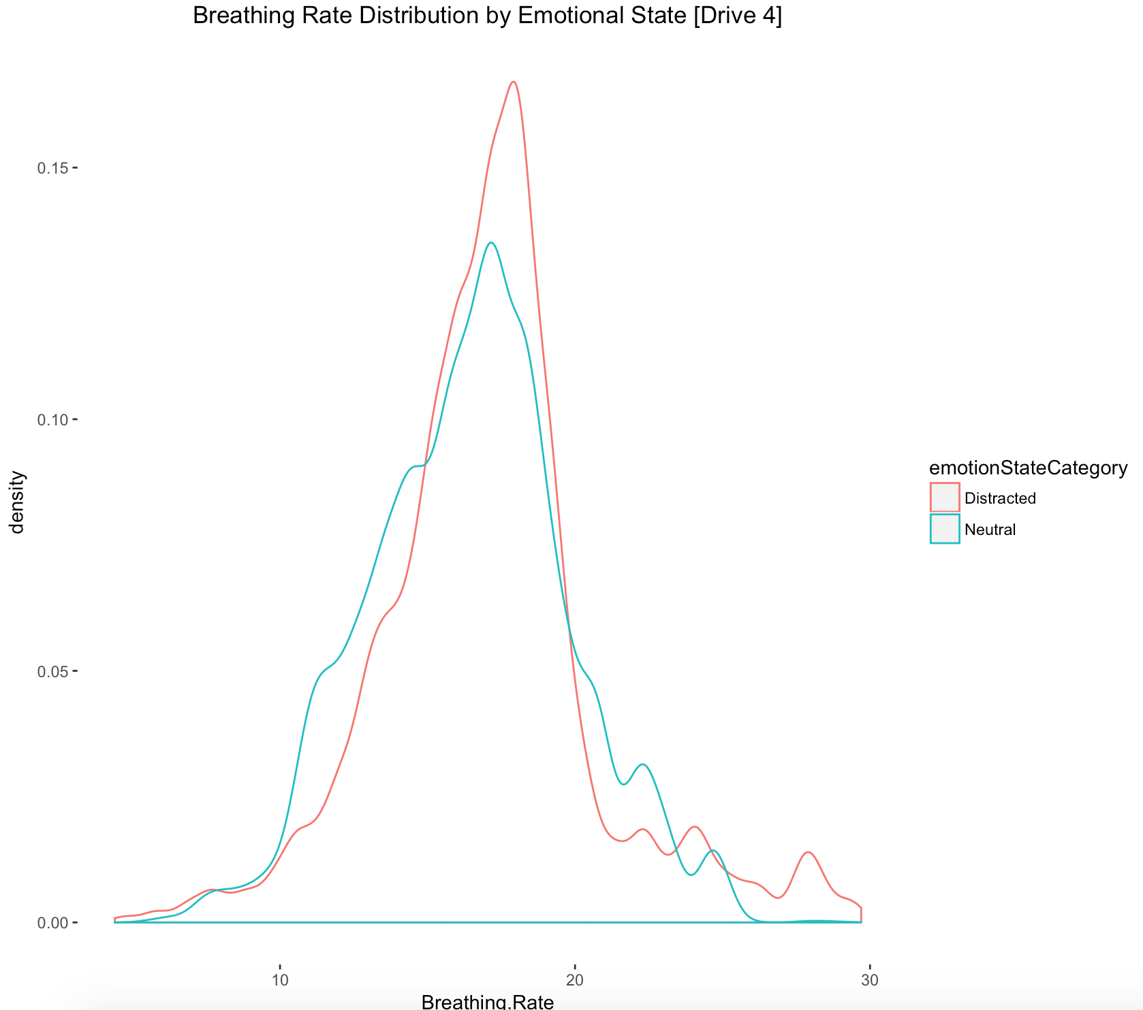
Heart Rate and Breathing Rate both appear to be somewhat higher in emotional drivers

Slide 10
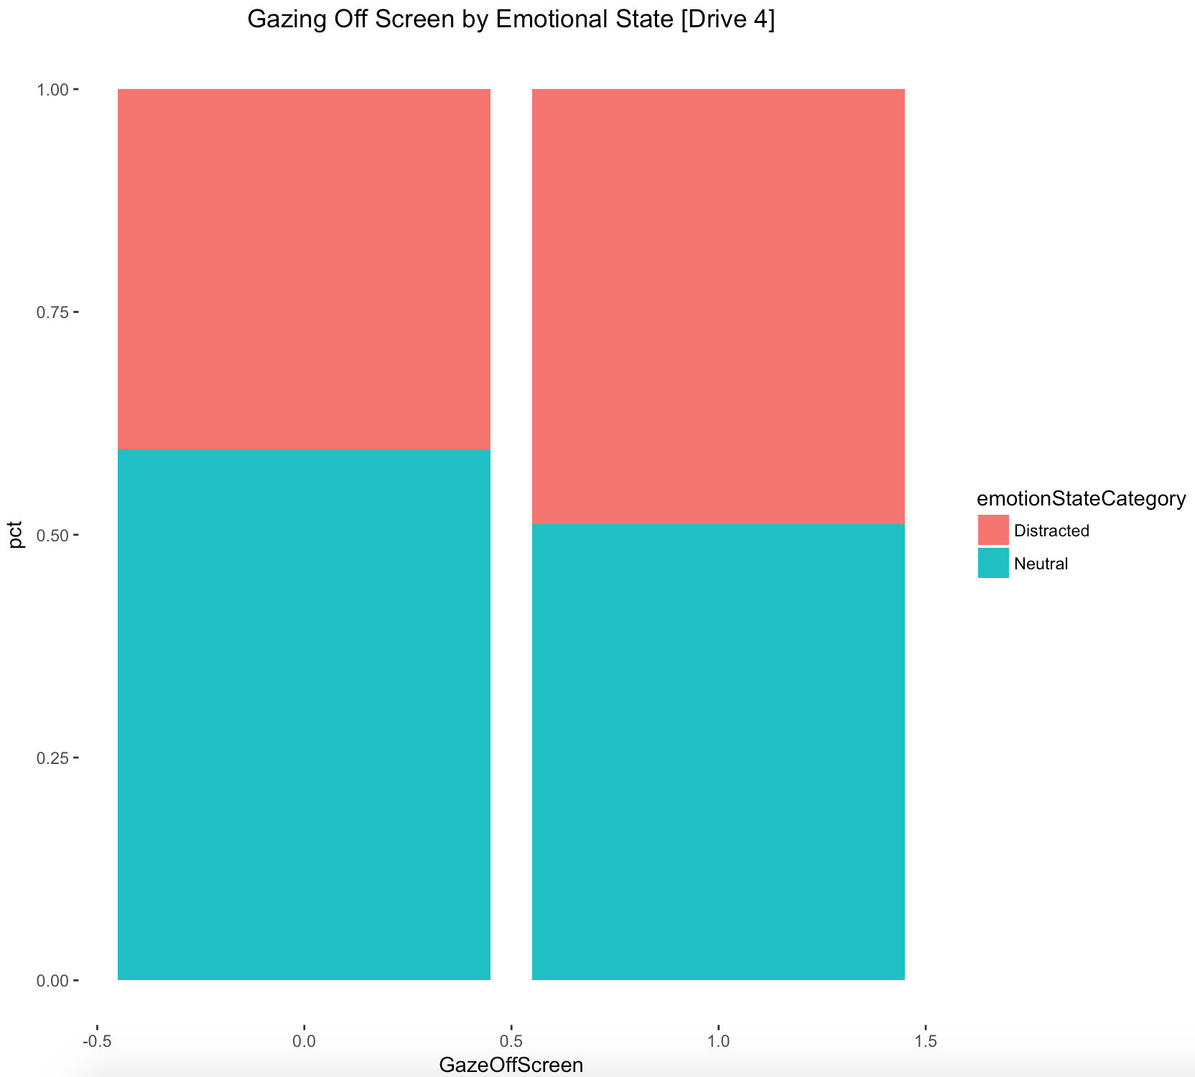
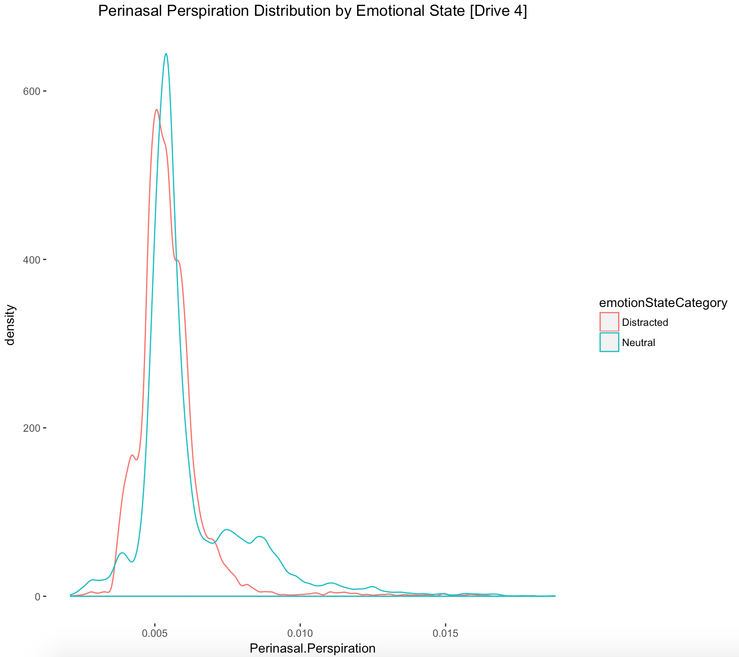
Perinasal Perspiration and not looking away from the screen tend to indicate a driver is less distracted

Slide 11
Modeling

Slide 12
Modeling & Statistical Approach
Our target variable is the emotional state of the driver; with our target emotion being ‘distracted’
Baseline drivers are labeled either ‘Neutral’ or ‘Disgusted’ by the software; Distracted includes other emotions
We will use binomial logistic regression. We use EDA to choose a list of potential starting variables then use backward selection to construct our model. Finally, we use a 80/20 Train/Test setup with our goal being to maximize prediction accuracy
Driver was treated as a random effect; all other variables were considered to be fixed effects
Continuous variables (Heart Rate, Breathing Rate, etc.) were range normalized (Subtracted minimum, divided by range)
A good deal of the values were NA; the issue did not appear to be systemic so they the points were removed from the modeling

Slide 13
We considered a few different models during our analysis; decided on the version with interaction terms
Only Main Effects
Interaction Effects Model
Model:
isBraking + HRNorm + SteeringNorm + Gender + PerinasalNorm + BreathingNorm + GazeOffScreen +
(1|Subject) + Drive + Stimulus
AIC: 84128
BIC: 84300
Test Somer’s D: .7926
Test Accuracy: .8297
Model:
isBraking + HRNorm + SteeringNorm + Gender + PerinasalNorm + BreathingNorm + GazeOffScreen + Gender:Perinasal + Gender:Breathing + (1|Subject) + Drive + Stimulus
AIC: 83983.8
BIC: 84175.0
Test Somer’s D: .7950
Test Accuracy: .8311

Slide 14
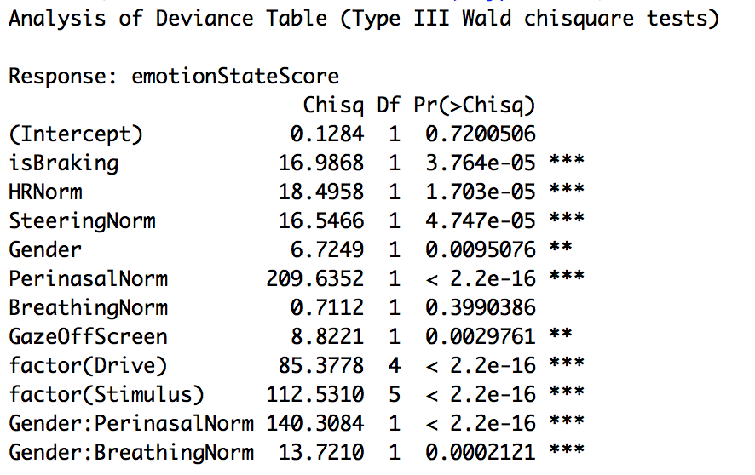
Using Type III Anova, all of the fixed effects in our model are significant
Note; only includes fixed effects

Slide 15
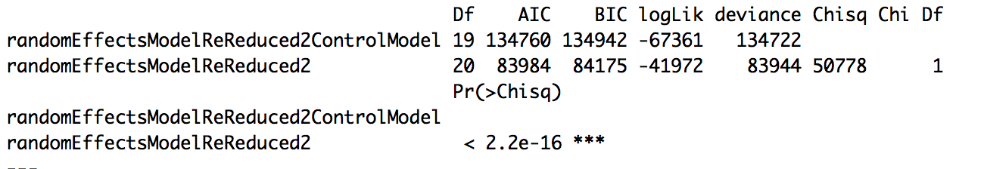
Comparing the GLMM with a simple GLM that doesn’t include the subject random effect shows the value is highly significant
GLM – No Random Effects
GLMM
While not a perfect approach, the random effect subject is clearly large and significant. The fully correct p-value would involve a computationally intensive MCMC approach not easily done on my machine

Slide 16
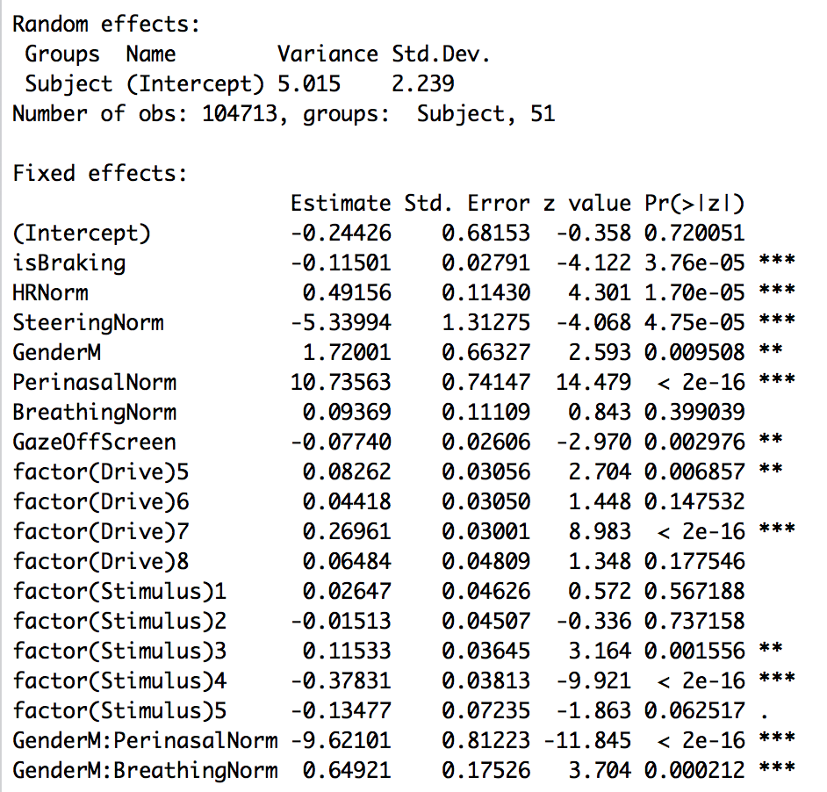
We note primarily that our variable of interest doesn’t enter the model; steering instead enters
Key Model Takeaways
Increased breathing / heart rates are predictive of being emotional. Breathing rate is a bigger predictor in men
Braking & gazing off screen in our model are indicative of a less emotional driver
Perinasal Perspiration in our model is highly indicative of a more emotional driver; especially for women
Interesting since we saw the opposite in the unadjusted EDA
As a note, I tried including Age and interaction terms between Age + HR & BR. The terms were significant, but the model was less predictive in the test set

Slide 17
41.7% of our observations will be flagged as distracted; this aligns with the ~42% in the source data
Quantile | Distracted % | Neutral %
10% | 2.1% | 97.9%
20% | 4.8% | 95.2%
30% | 8.2% | 91.8%
40% | 12.6% | 87.4%
50% | 25.7% | 74.3%
60% | 44.2% | 55.8%
70% | 67.9% | 32.1%
80% | 76.5% | 23.5%
90% | 86.8% | 13.2%
100% | 92.8% | 7.2%

Slide 18
The Model looks great; The ROC curve and predictive diagnostics check out
Predictive Diagnostics
 | Training | Test
Somer’s D | .791 | .795
Accuracy | .829 | .831
Sensitivity | .792 | .793
Specificity | .855 | .858

Slide 19
Summary
Our model does a great job predicting emotional state; the predictive power is quite strong [with accuracy >80%].
Perspiration, heart rate, and breathing rate are all positive predictors of being emotionally distracted; Gazing off screen and braking are, when normalizing for other variables, indicative of less emotionally distracted driving
A decent amount of these predictors [perspiration, heart rate] could be implemented unobtrusively in a steering wheel; there is certainly opportunity to try implementing / brainstorming an automotive feature that [Alerts driver? (Perhaps too annoying) Controls acceleration?] when the driver is emotionally distracted

Slide 20
Appendix

Slide 21
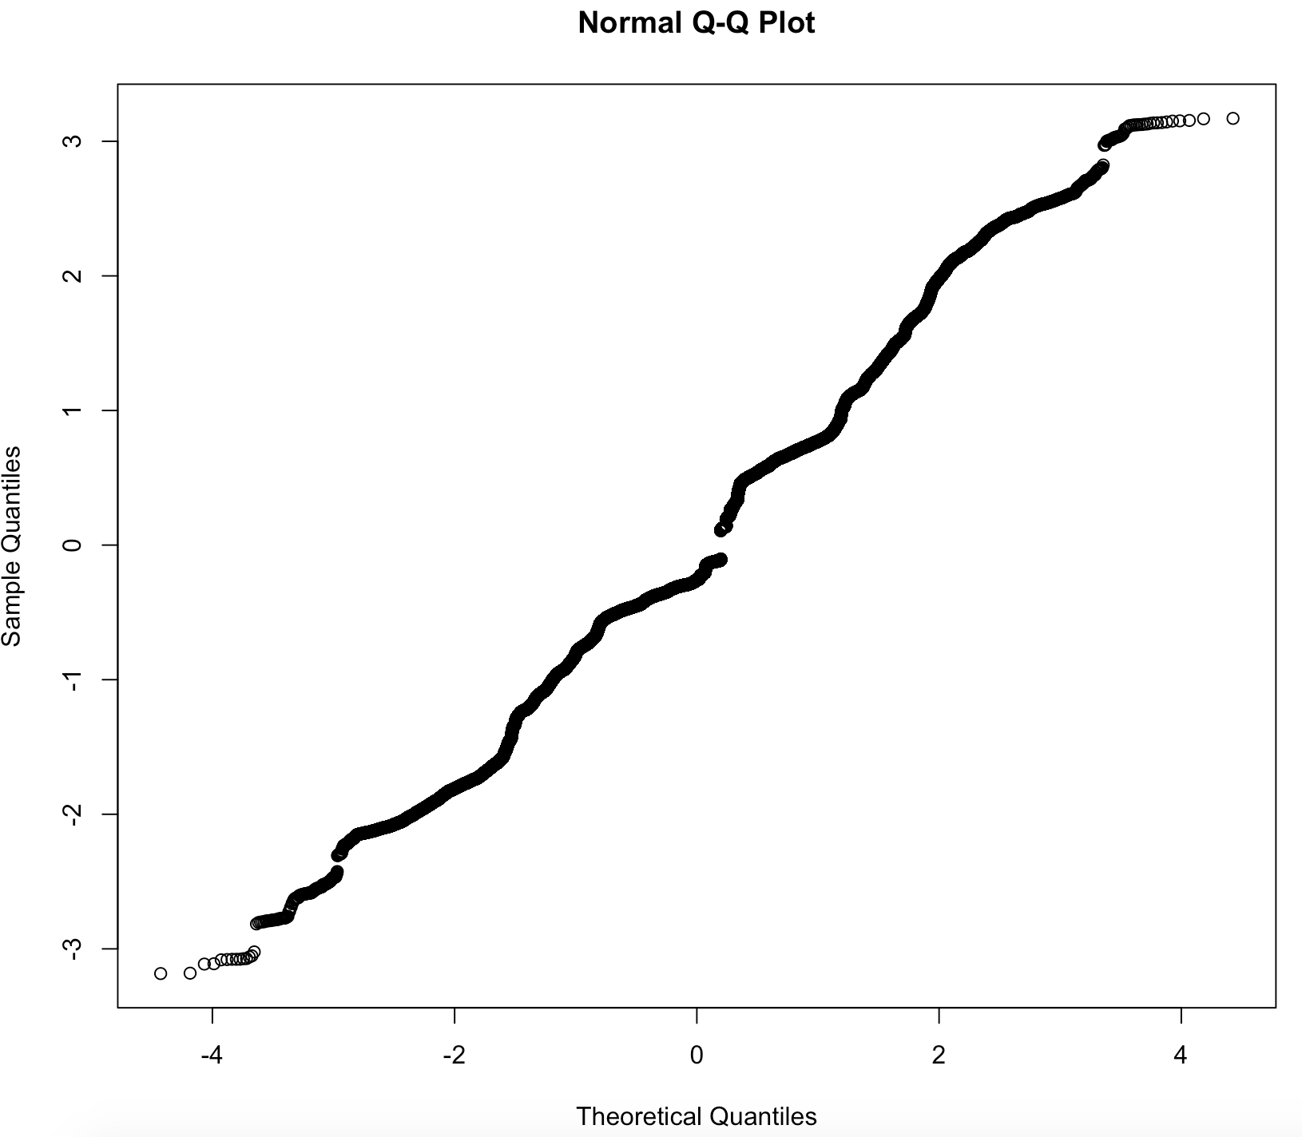
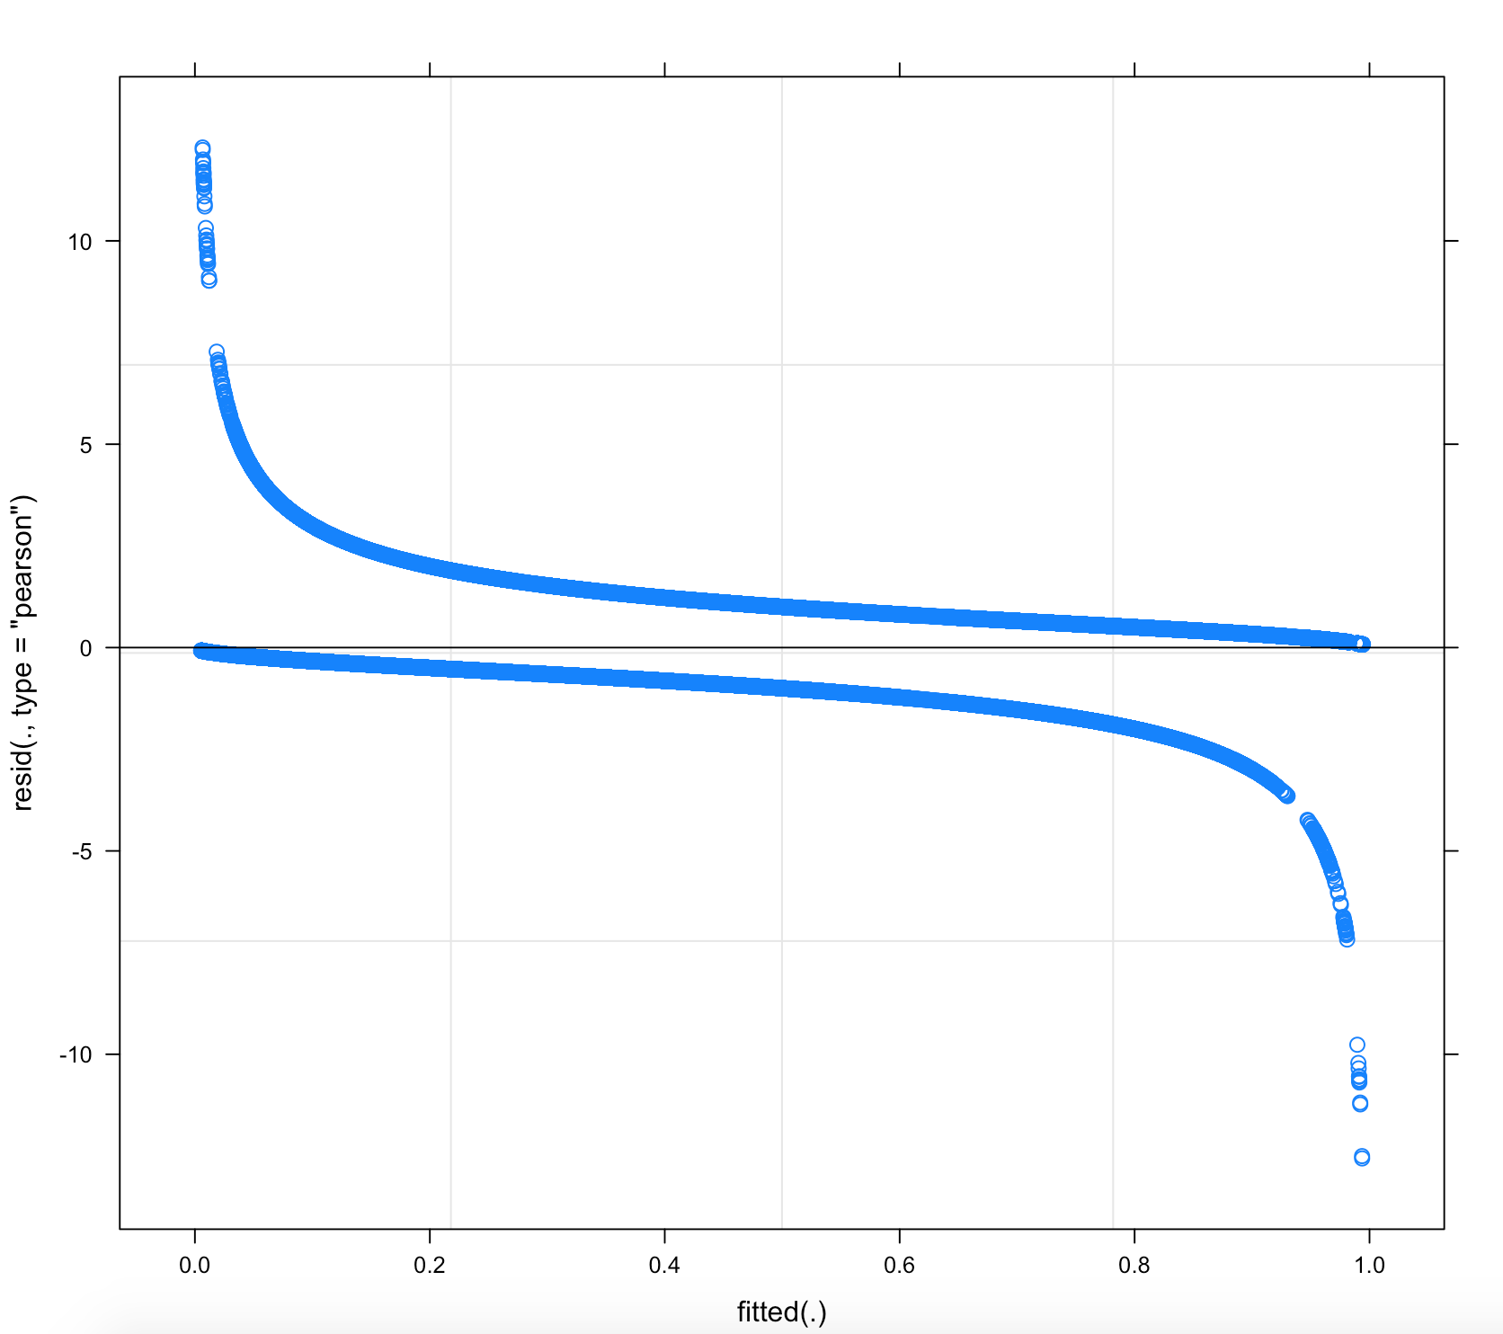
The model diagnostics check out; residuals are reasonably distributed / appear normal

Slide 22
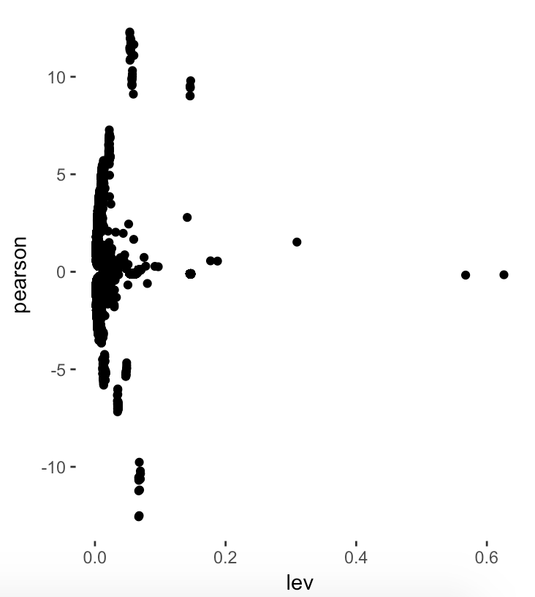
Leverage vs. Residuals

